Slide 1








You can suffer from asthma. Or you can have it under control.

Slide 2

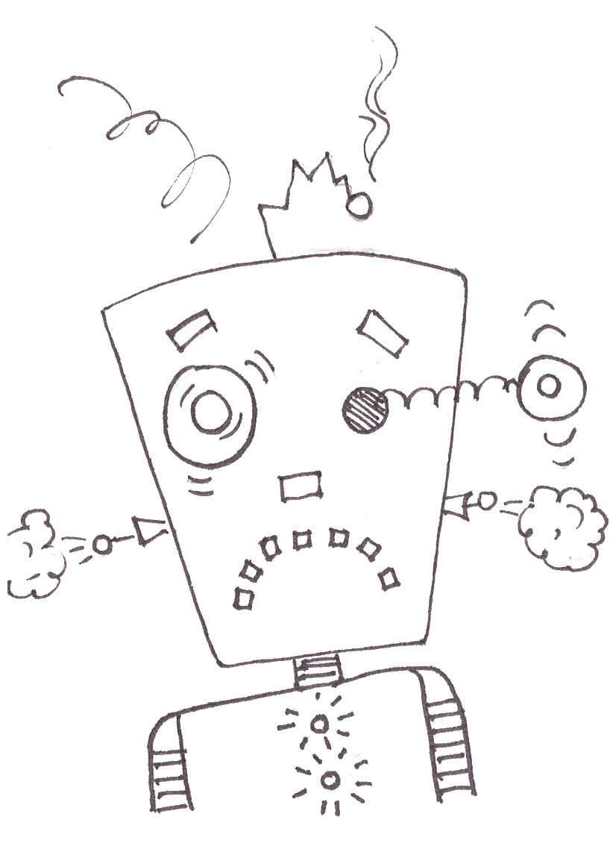
AsthmaDroid
Notes:
You can suffer from asthma. Or you can have it under control.

